Slide 1
Snowflake - Session
Day-6

Slide 2
DATA SHARING
Secure Data Sharing enables sharing selected objects in a database in your account with other Snowflake accounts. The following Snowflake database objects can be shared:
Tables
External Tables
Secure views
Secure Materialized views
Secure UDFs
Snowflake enables the sharing of databases through shares, which are created by data providers and “imported” by data consumers.
All database objects shared between accounts are read-only (i.e., the objects cannot be modified or deleted, including adding or modifying table data).
Any full Snowflake account can both provide and consume shared data. Snowflake also supports third-party accounts, a special type of account that consumes shared data from a single provider

Slide 3
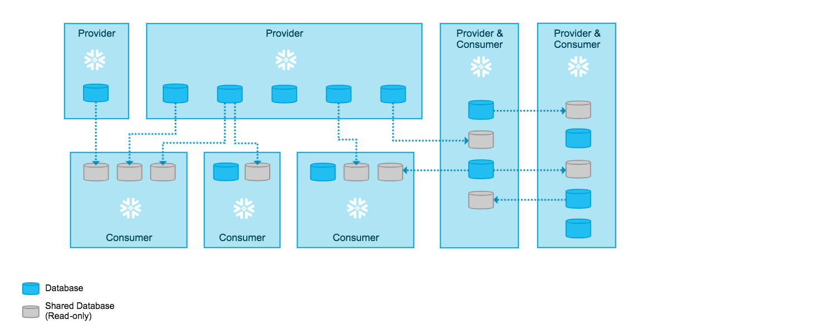
DATA SHARING

Slide 4
Usage metrics shared with Providers
Snowflake data providers have access to the following metrics about consumers who access their data:
Consumer’s Snowflake account name
Consumer’s Snowflake organization name
Statistical data on the data consumption, including:
Date of the consumption.
The number of queries a consumer account runs on a provider’s share. The data is provided at the daily aggregate level.
Any information a consumer provides when submitting a data request for a personalized listing, such as the consumer’s business email and company name.

Slide 5
DATA MARKETPLACE
As a data provider, you can:
Publish data listings for free-to-use datasets to generate interest and new opportunities among the Snowflake customer base.
Publish data listings for datasets that can be customized for the consumer.
Share live datasets securely and in real-time without creating copies of the data or imposing data integration tasks onto the consumer.
Eliminate the costs of building and maintaining APIs and data pipelines to deliver data to customers.
As a data consumer, you can:
Discover and test third party data sources.
Receive frictionless access to raw data products from vendors.
Combine new datasets with your existing data in Snowflake to derive new business insights.
Have datasets available instantly and updated continually for users.
Eliminate the costs of building and maintaining various APIs and data pipelines to load and update data.
Use the BI tools of your choice.

Slide 6
Snowflake Market Place
The Snowflake Marketplace utilizes Snowflake Secure Data Sharing to connect providers of data with consumers.
You can use the Snowflake Marketplace to discover and access third-party data and services, as well as market your own data products across the Snowflake Data Cloud.
As a data provider, you can use listings on the Snowflake Marketplace to share curated data offerings with many consumers simultaneously, rather than maintain sharing relationships with each individual consumer. With Paid Listings, you can also charge for your data products.
As a Provider you can: Publish listings for free datasets to generate interest and new opportunities among the Snowflake customer base, Publish listings for customized datasets, Share live datasets securely and in real-time without creating copies of the data or imposing data integration tasks on the consumer, Eliminate the costs of building and maintaining APIs and data pipelines to deliver data to customers.
As a Consumer you can: Discover and test third-party data sources, Receive frictionless access to raw data products, Combine new datasets with your existing data in Snowflake to derive new business insights, Have datasets available instantly and updated continually for users, Eliminate the costs of building and maintaining various APIs and data pipelines to load and update data.

